Slide 1

Employee Management System
Presented by
Boddu Chaitanya
Batch No : 435
Innomatics Research Labs – Dilsukhnagar

Slide 2


Agenda
Business Problem Statement
Objective of the Project
ER Diagram
Tables
Key analysis questions
SQL query results with screenshots or summaries
Final business insights
Conclusion

Slide 3

Business Problem Statement
Employee data is often maintained across multiple systems or manual records, leading to inconsistencies and errors. The lack of a centralized database causes data duplication, mismatches, and delayed updates. This makes it difficult to accurately track employee details, leave records, and payroll information. Payroll miscalculations occur due to incorrect or outdated data, and manual handling increases human errors.
As a result, HR reporting becomes time-consuming and overall operational efficiency is reduced.

Slide 4

Objective of the Project
To design a structured database for efficient management of employee data.
To manage employee details, job roles, departments, qualifications, and leave records systematically.
To automate payroll, salary, and bonus calculations with accurate integration of leave data.
To ensure data integrity and consistency using keys, constraints, and relationships.
To generate analytical reports and insights using core SQL concepts to support decision-making and organizational growth.

Slide 5
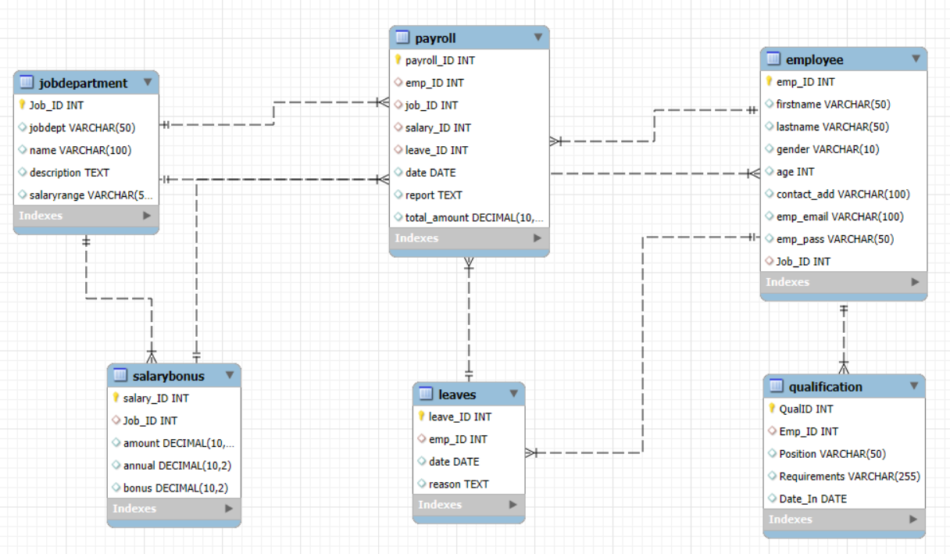
ER Diagram

Slide 6
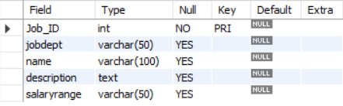
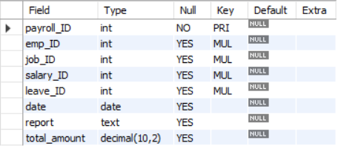
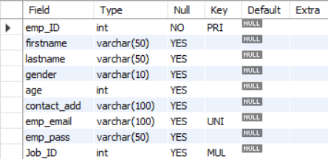
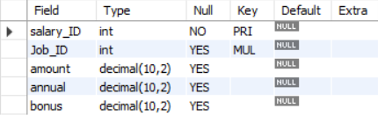
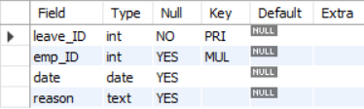
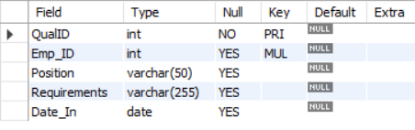
Tables
Job Department Table Payroll Table Employee Table
Salary Bonus Table Leaves Table Qualification Table

Slide 7
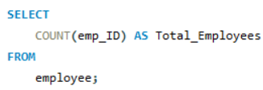
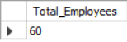
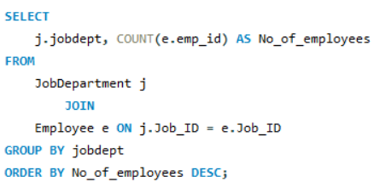
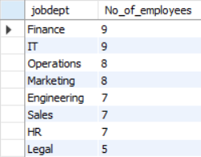
Key analysis questions
How many unique employees are currently in the system?
Which departments have the highest number of employees?

Slide 8
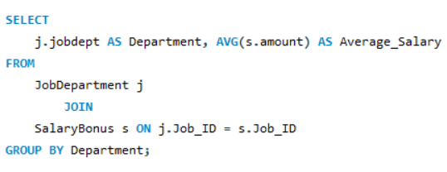
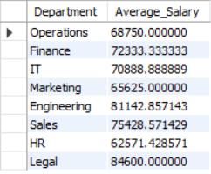
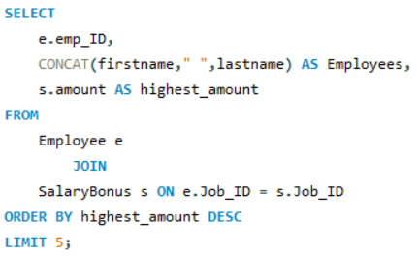
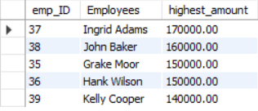
What is the average salary per department?
Who are the top 5 highest-paid employees?

Slide 9
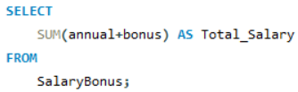
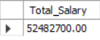
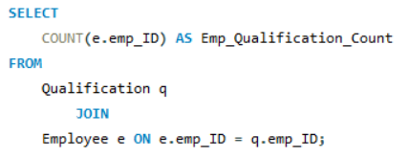
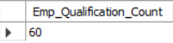
What is the total salary expenditure across the company?
How many employees have at least one qualification listed?

Slide 10
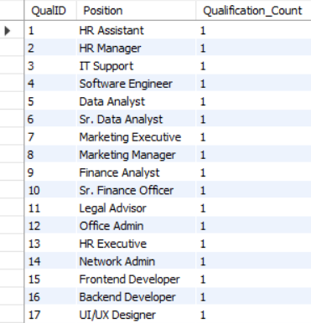
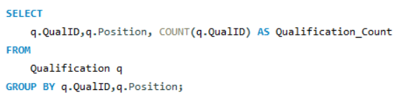
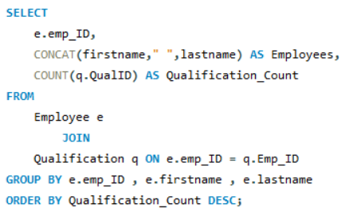
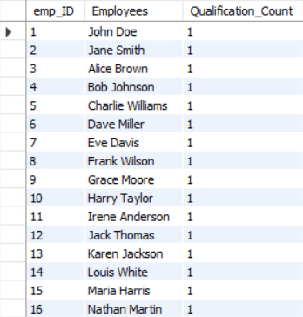
Which positions require the most qualifications?
Which employees have the highest number of qualifications?

Slide 11
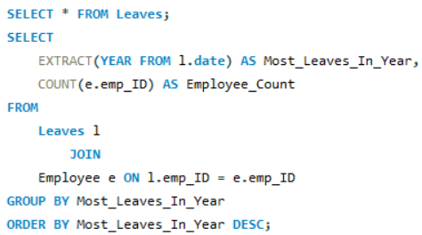
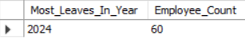
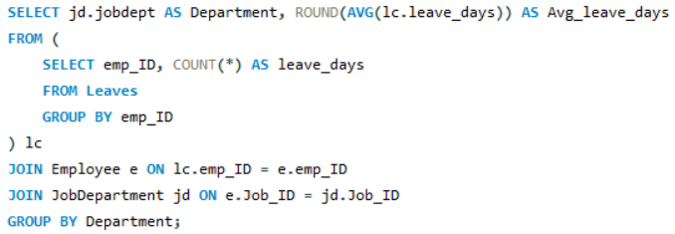
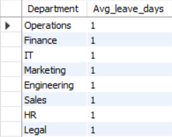
Which year had the most employees taking leaves?
What is the average number of leave days taken by its employees per department?

Slide 12
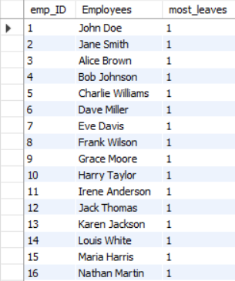
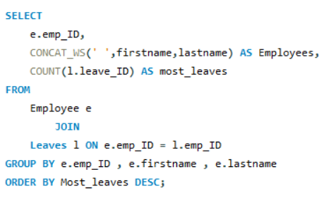
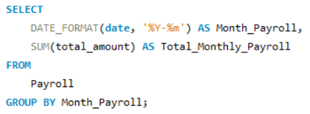
Which employees have taken the most leaves?
What is the total monthly payroll processed?

Slide 13
Final Business Insights
Centralized employee and payroll data enables faster, data-driven HR and management decisions.
Department-wise salary and bonus analysis helps identify high-cost roles and optimize budgets.
Integrated leave and payroll data reveals attendance patterns impacting productivity and compensation.
Qualification and skill analysis highlights workforce gaps, supporting training and hiring strategies.

Slide 14
Conclusion
The Employee Management System efficiently manages employee, job, payroll, qualification, and leave data using a relational database. It ensures data accuracy and consistency through well-defined relationships and constraints. The system simplifies payroll processing and leave management through integrated data handling.
Centralized data storage improves HR efficiency and supports informed decision-making. Overall, the project demonstrates the value of database-driven solutions in HR management.

Slide 15
Q&A

Slide 16

THANK YOU

